Slide 1
CASE STUDY ON funding information of the Indian startups from January 2015 to August 2017

Slide 2
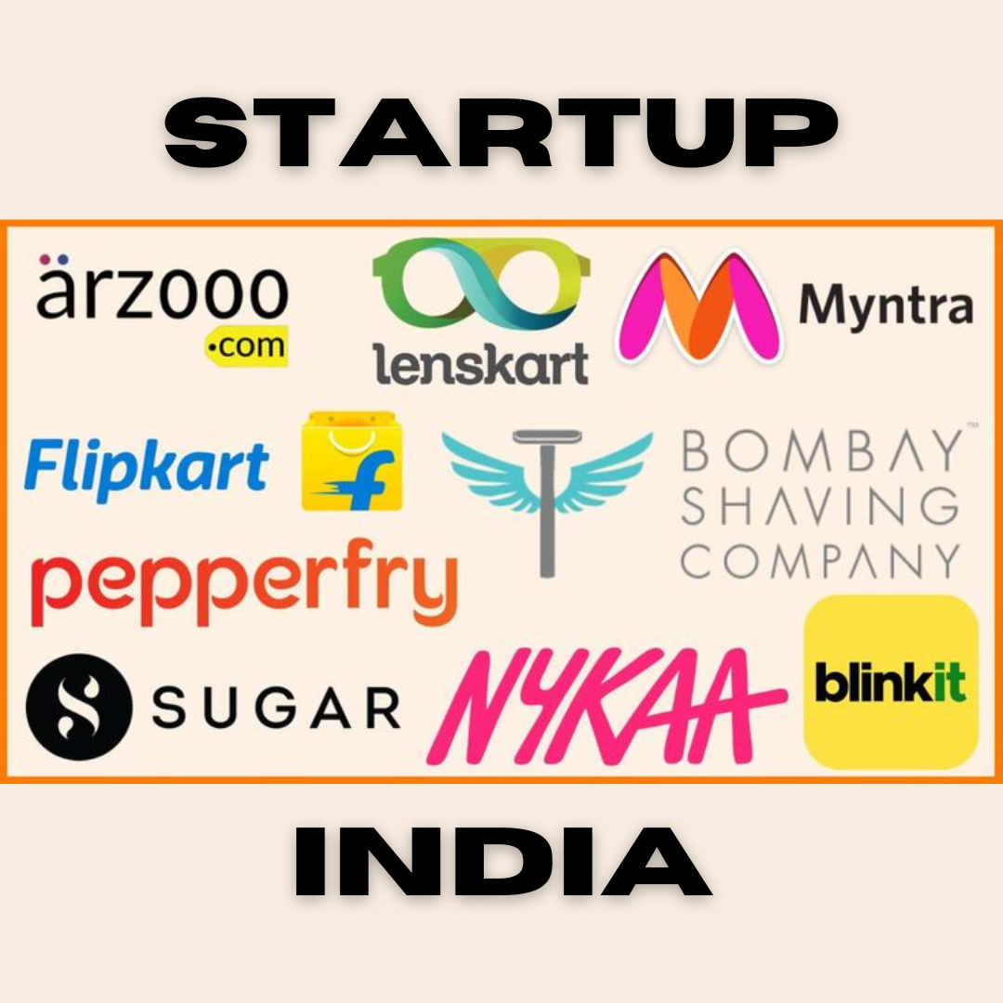
Business Problem
In the rapidly evolving landscape of Indian startups from January 2015 to August 2017, a comprehensive analysis of funding information is required to unearth valuable insights. The project aims to answer key questions and provide strategic recommendations for stakeholders in the startup ecosystem.

Slide 3
Specifically the analysis will focus on
TYPES OF FUNDED STARTUPS
Identify the dominant types of startups that have secured funding in the last few years.
Determine if there are emerging trends in the types of startups receiving funding over time.
Provide a breakdown of funding distribution across different startup categories.
KEY INVESTORS
Identify and profile the important investors contributing significantly to the Indian startup ecosystem.
Analyze the investment patterns of these key investors, including sectors and stages they are more inclined to invest in.
Evaluate the influence of these investors on the overall funding landscape.
HOT FIELDS FOR FUNDING
Determine the sectors or industries that have attracted substantial funding during the specified period.
Analyze any shifts or trends in the funding preferences across different fields.
Provide insights into the characteristics that make certain fields more attractive to investors.
These insights will offer a comprehensive understanding of the current dynamics in the Indian startup ecosystem, guiding stakeholders in making informed decisions about investments, partnerships, and strategic directions.

Slide 4
Problem Statement
Check the trend of investments over the years.
Year | Number of Funding
2015.0 | 929
2016.0 | 993
2017.0 | 687
2018.0 | 309
2019.0 | 111
2020.0 | 7

Slide 5
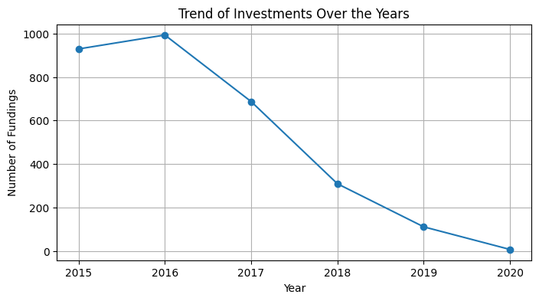
From the below visual interpretation of the data we can clearly see a decreasing trend of investments over the years(2015 to 2020)

Slide 6
Problem Statement
Find out which cities are generally chosen for starting a startup.
The top 10 Indian cities which have most number of startups are:
Bangalore 850
Mumbai 573
New Delhi 463
Gurgaon 292
Pune 112
Hyderabad 100
Chennai 98
Noida 94
Gurugram 50
Ahmedabad 41

Slide 7
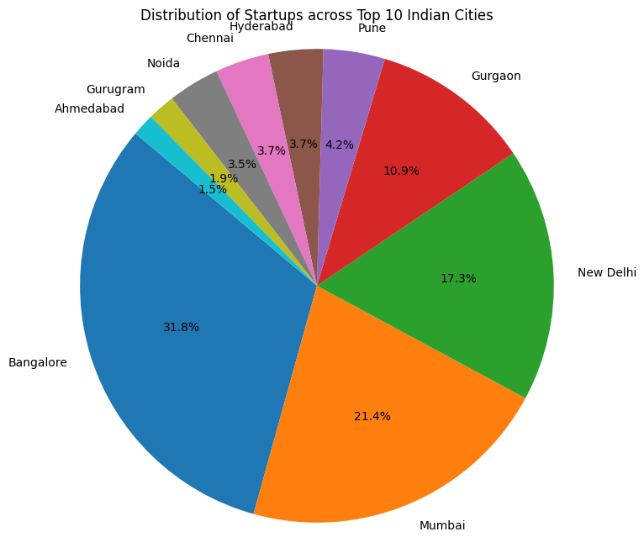
Bangalore city has most number of startups

Slide 8
Problem Statement
Find out if cities play any role in receiving funding.
City Location Amount in USD
Bangalore 18502366863.0
Mumbai 4939225015.0
New Delhi 3358571515.0
Gurgaon 3006496134.54
Noida 1263164000.0
Gurugram 865932523.0
Chennai 718767000.0
Pune 717582000.0
Hyderabad 401676230.0
India Other 349500000.0

Slide 9
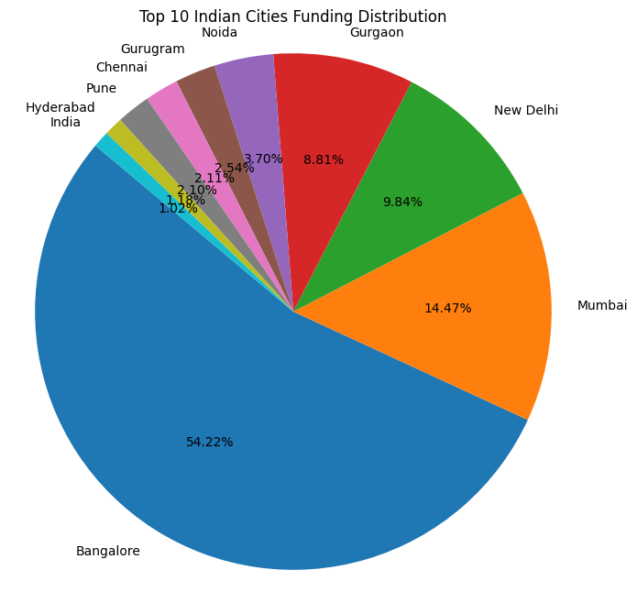
Bangalore city has got maximum funding.

Slide 10
Problem Statement
There are 4 different type of investments. Find out percentage of amount funded for each investment type
Crowd Funding 0.00%
Debt Funding: 0.09%
Private Equity 93.45%
Seed Funding 5.48%

Slide 11
Problem Statement :
Which type of companies got more easily funding.
Find-
Top 5 industries and percentage of the total amount funded to that industry. (among top 5 only)
Ecommerce: 21.59%
Consumer Internet: 16.98%
Transportation: 10.64%
Technology: 6.05%
Finance: 5.35%
Thus Ecommerce type of companies tend to got more easily funded.

Slide 12
Problem Statement
Find top 5 startups with most amount of total funding.
Start Up Amount In USD
Flipkart 4760700000.0
Rapido 3900751230.0
Paytm 3348950000.0
Ola 2107181200.0
Oyo 997000000.0

Slide 13
Problem Statement :
Find the top 5 startups who received the most number of funding rounds
Flipkart 4760700000.0
Rapido 3900751230.0
Paytm 3348950000.0
Ola 2107181200.0
Oyo 997000000.0
Start Up Amount in USD

Slide 14
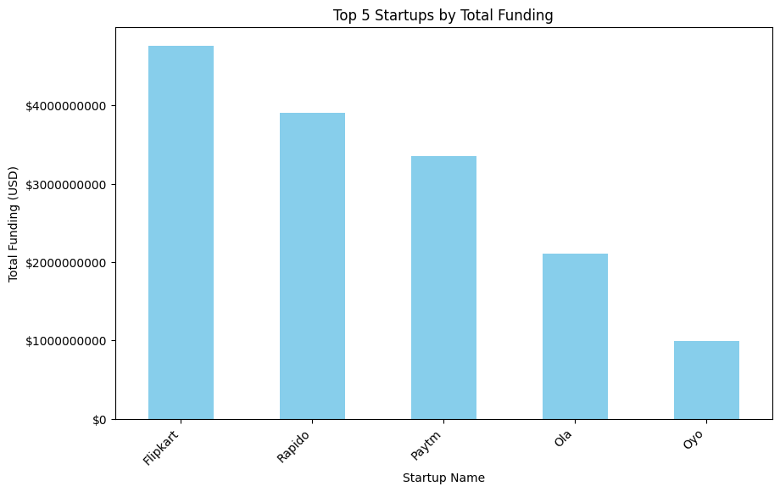

Slide 15
Problem Statement
Find the top 5 startups who received the most number of funding rounds
Startup Number of Fundings
Ola 22
Oyo 9
Swiggy 8
Flipkart 7
Paytm 6

Slide 16
Important Investors
Investors Name Amount In USD
Softbank 3962000000.0
Westbridge Capital 3915600000.0
Microsoft, eBay, Tencent Holdings 1400000000.0
Vijay Shekhar Sharma 1000150000.0
Steadview Capital and existing investors 700000000.0

Slide 17
Findings & Suggestion
1.Startups in the category of transportation and Ecommerce are getting funded in the last few years.T
2.The top 5 investors are:
1.Softbank 2.Westbridge Capital 3.Microsoft, eBay, Tencent Holdings 4.Vijay Shekhar Sharma 5.Steadview Capital and existing investors.
3.Ecommerce and Transportation are the hot fields that get a lot of funding these days.
Banglore city has got major share of start Ups and also gets maximum funding.

